Slide 1
LNHS PTSA Wednesday, August 23, 2023 6:30pm General Meeting
Followed By
MEET THE LEADERSHIP TEAM & HOW TO GET INVOLVED AT LNHS

Slide 2
LNHS PTSA Meeting Agenda August 23, 2023
Agenda:
Welcome/Confirm Quorum
Meeting Called to Order by President
Introductions/Special Guests
Position Board Members
President Gita Raghoonandan
1st VP - Membership Brenda Meadows
Treasurer Christal Feldman
Recording Secretary Juhi Shah
Corresponding Secretary Gloria O’Neal
Chairs
LWL Co-Advisors Tania Abreu & Becky Santiago
Finance Chair Teresa Gulino
Staff Appreciation Angie Garcia & Hannah Howell
Web Master Erika Remley
Staff Liaison Kari Grimm
Staff Liaison Cristen Krugh
OLD BUSINESS
Approval of Past Minutes (May)
Review of Annual Financial Report
NEW BUSINESS
President’s Report
Membership Updates
Spirit Wear Sales & Legacy Brick Campaign
Staff Appreciation
Learn with Lions
Vote on 2023-2024 Proposed Budget
Communication Updates
Next Meeting - Wednesday, September 20th
Meeting Adjourned by President
August Meeting Topic: MEET THE LEADERSHIP TEAM & HOW TO GET INVOLVED

Slide 3
Our mission is to make every child’s potential a reality by engaging and empowering families and communities
to advocate for all children.
To help our students succeed
by building strong community partnerships,
supporting teachers and staff,
providing quality STEM opportunities,
and making college and career connections.

Slide 4
PAST MINUTES FOR APPROVAL General Meeting May 16, 2023
FINANCIAL REPORT FOR APPROVAL July 2023 Financial Report
Year to Date Summary 2022-2023 Audit Completed on July 12, 2023 Bank Statements and My PTez Balanced 2023-2024 Beginning Balance $7,259.72

Slide 5
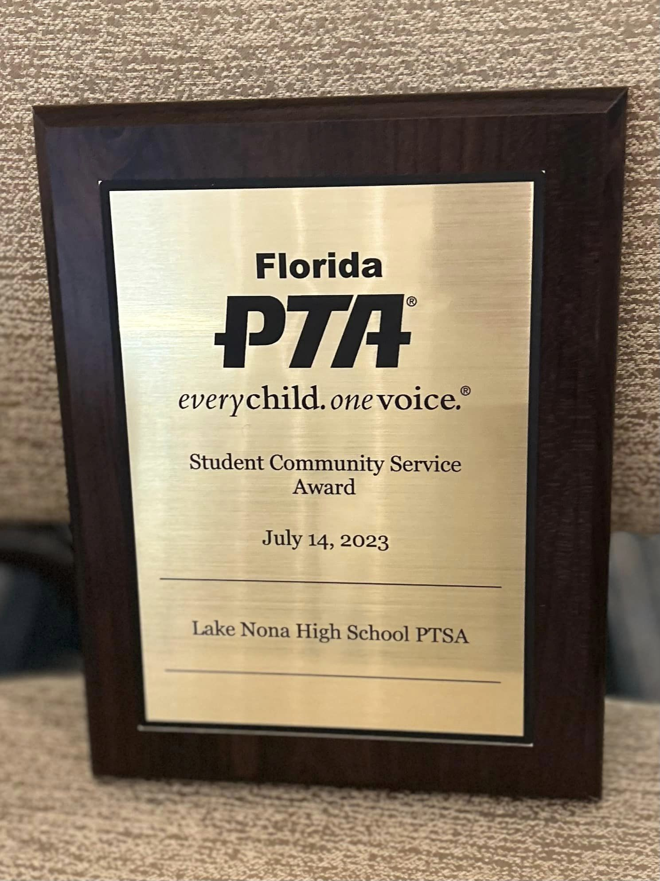
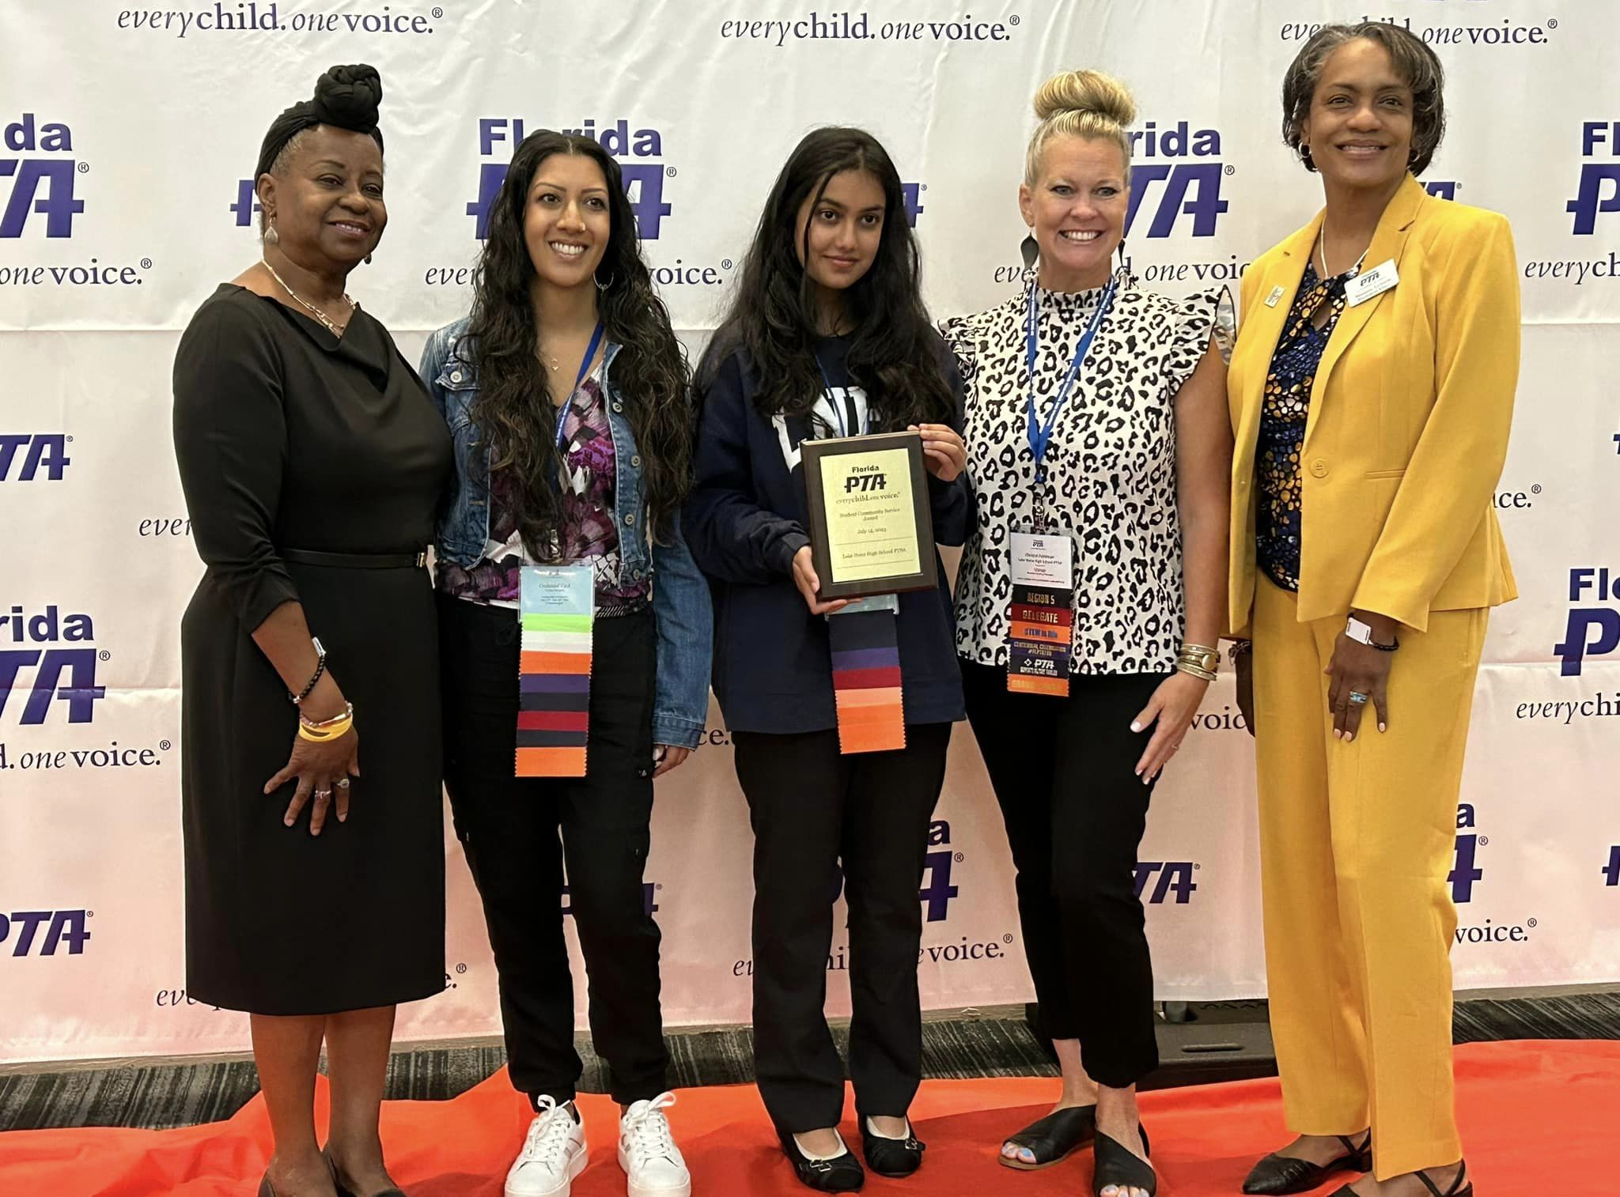
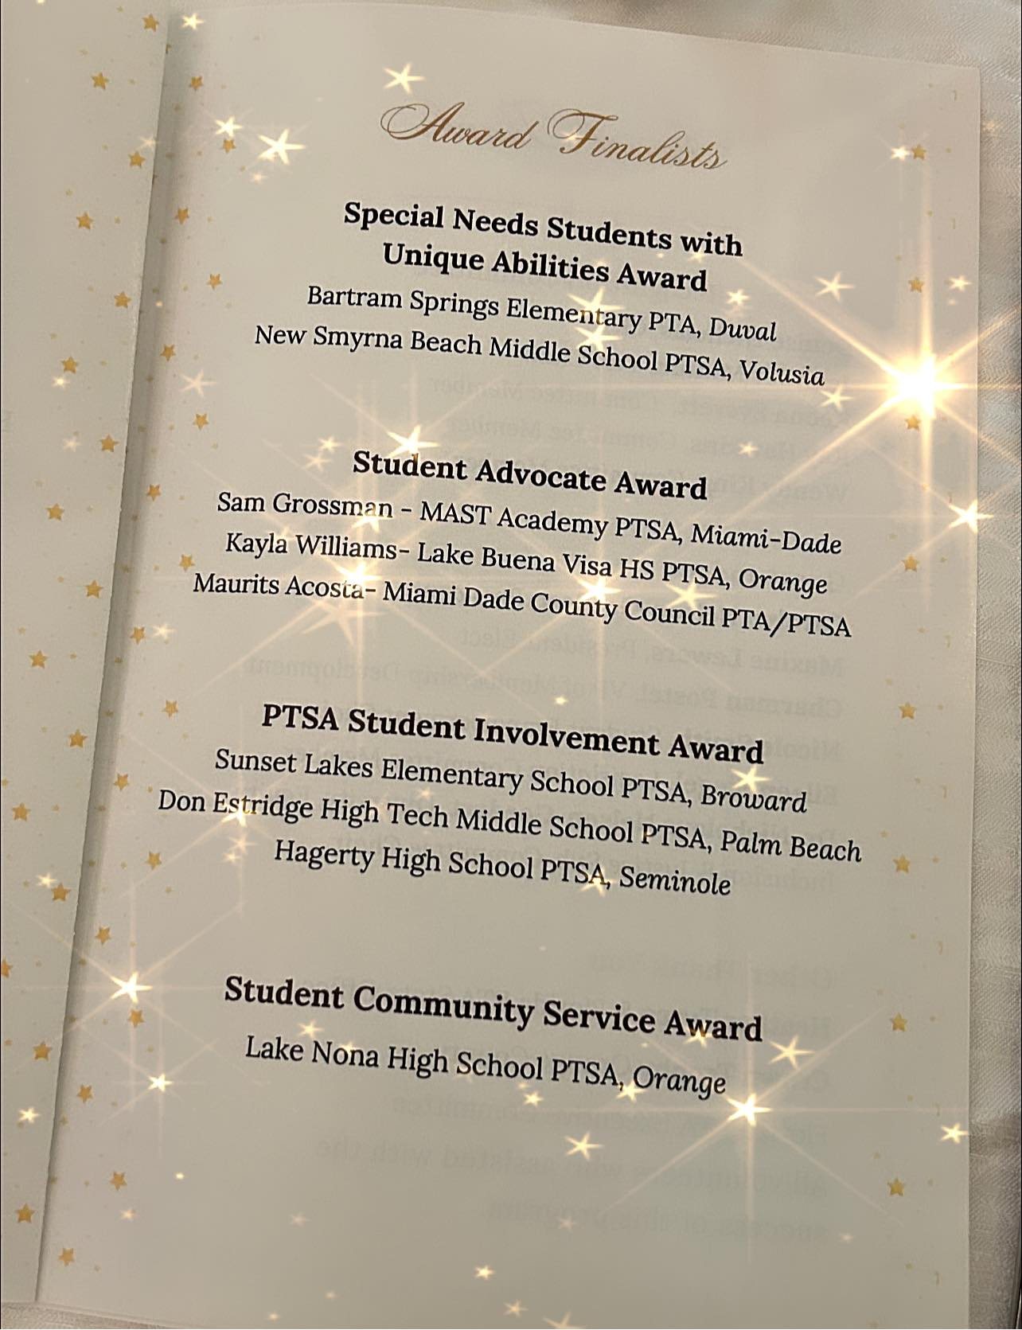
Our PTSA Board Members attended the FLORIDA PTA Leadership Conference this summer and we are so excited to announce that our Learn with Lions Virtual Tutoring Club has been recognized by receiving the STUDENT COMMUNITY SERVICE AWARD! We are so proud of our tutors, their advisors, the LNHS Administration, our local Elementary and Middle schools and the Lake Nona Regional Chamber of Commerce
for supporting this amazing community program!

Slide 6
Based on our Annual Survey,
we are planning the following programs:
Mental Health, Stress, Anxiety
Dual Enrollment
College and Career Readiness
Safety in Schools and more…

Slide 7
PTSA MEMBERSHIP Online Sales Started on July 19, 2023 Over 400 Memberships Received BEFORE School Started! Currently 470 Memberships Received (Well OVER Halfway to Our Goal of 850!) Membership Options Parent/Adult - $10 Teachers & Staff - $5 Students - $5 Community Members - $10 (Includes Discount Card)

Slide 8
SPIRIT WEAR - Online Sales Started on July 19, 2023 - New Options Available (Lanyards) - Currently OVER $15,000 in income (Return of the Pride, Athletic Games, Open House) - Limited Quantities & Sizes Available - Coming Soon: Online Pre-sale with New Styles

Slide 9
LEGACY
BRICK SALES Great Gift for Seniors & Alumni
Special Pricing for Clubs
Business Bricks Available

Slide 10
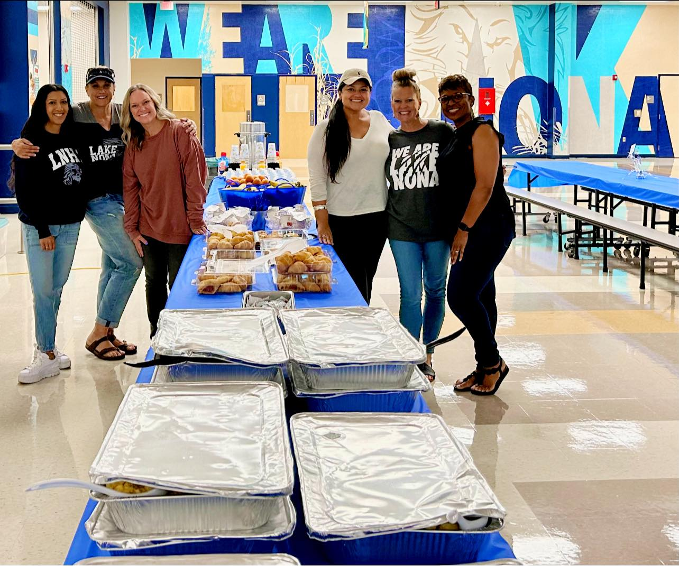
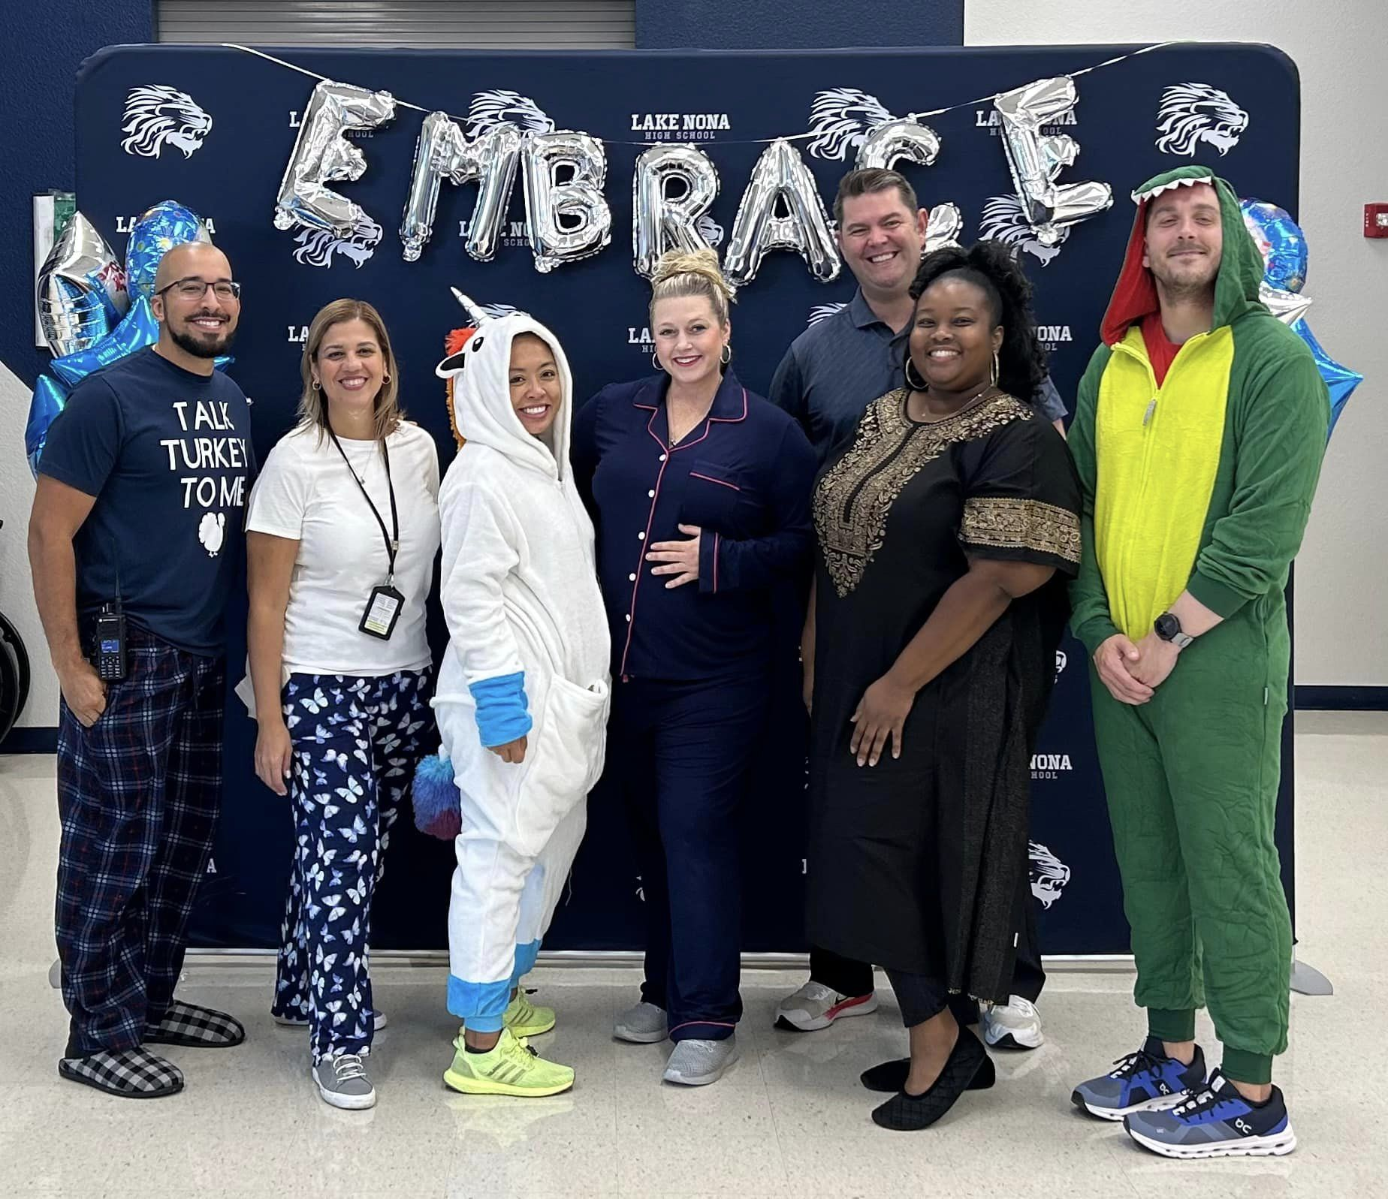
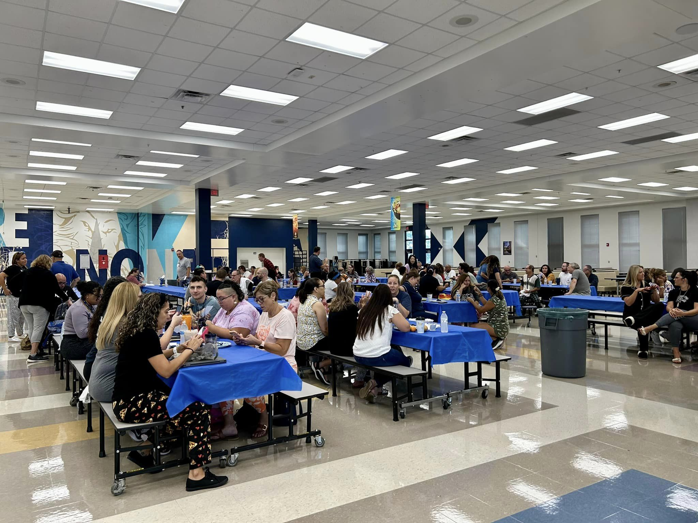
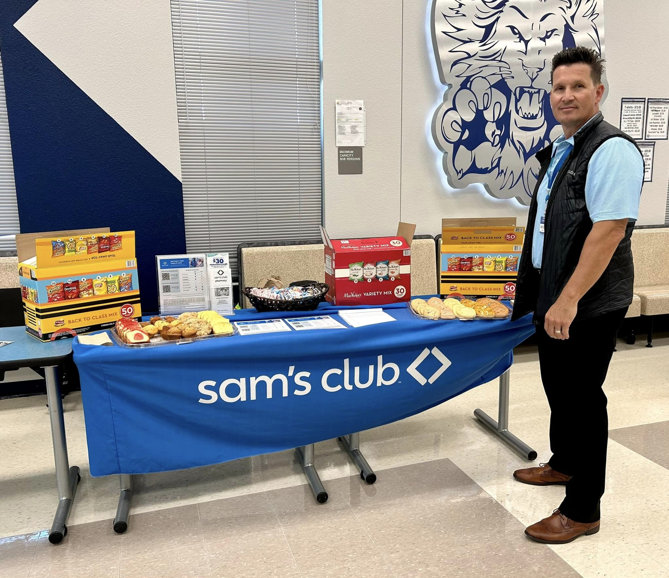
STAFF
APPRECIATION
August - Welcome Back Breakfast
THANK YOU TO OUR VOLUNTEERS AND COMMUNITY PARTNERS!

Slide 11
STAFF
APPRECIATION
SAVE THE DATE
Committee Meeting

Slide 13
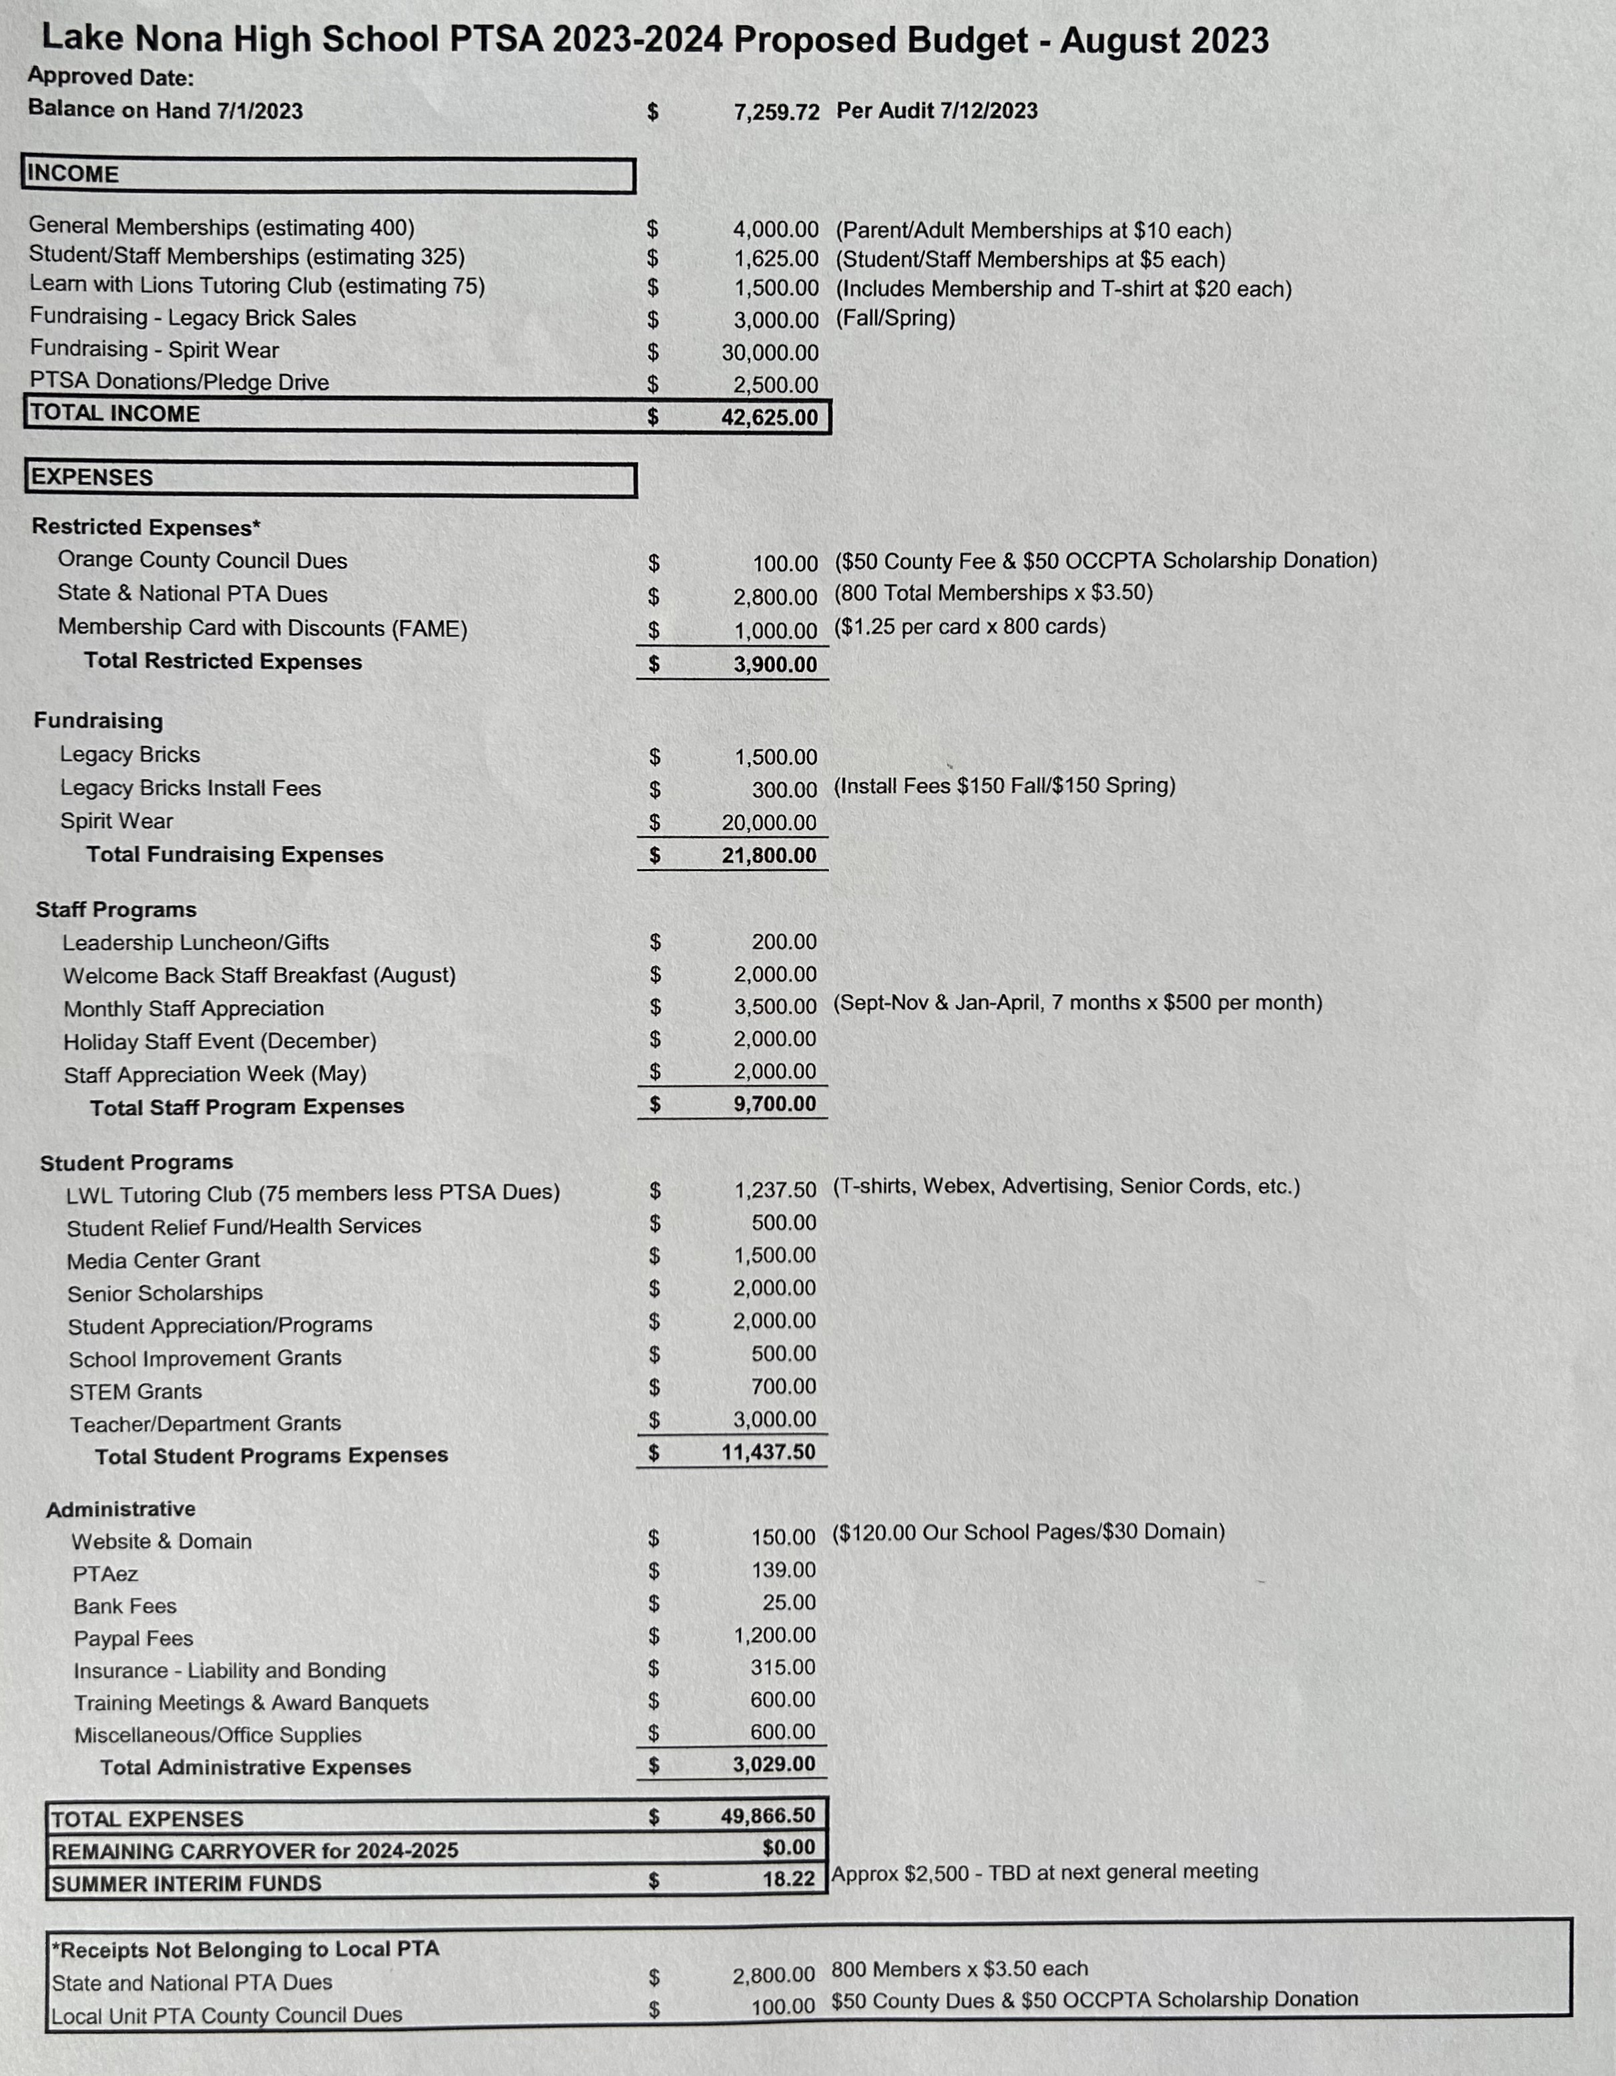
2023-2024
LNHS PTSA
PROPOSED BUDGET
FOR APPROVAL Annual Budget July 2023 - June 2024 Summary Beginning Balance - $7,259.72
Projected Income - $42,625.00
Projected Expenses - $49,866.50

Slide 14
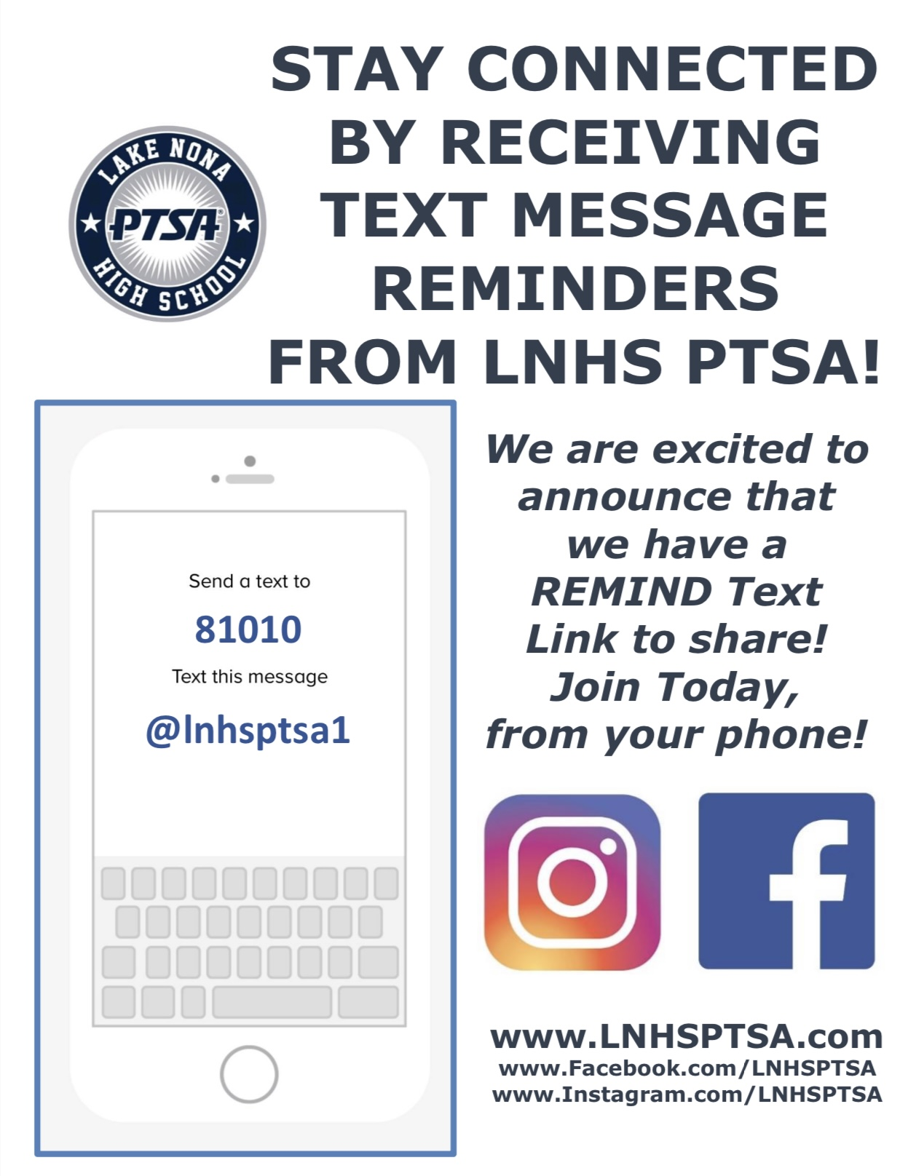
PTSA STAFF APPRECIATION

Slide 15
STAY CONNECTED
WITH LNHS PTSA
PTSA STAFF APPRECIATION
www.LNHSPTSA.com
www.Facebook.com/LNHSPTSA
SAVE THE DATE
Next General Meeting
Wednesday, September 20, 2023 at 6:30pm

Slide 16
LNHS PTSA August Meeting Topic
MEET THE LEADERSHIP TEAM

